Slide 1


Lack of Splicing Distinguishes piRNA-producing Transcripts from other RNAs in Mammals
Tianxiong Yu, Kaili Fan, Birgit Koppetsch, Philip Zamore*, William Theurkauf* and Zhiping Weng*
University of Massachusetts Chan Medical School
Mar 2022, 8th Annual RNA Symposium
Notes:
Good morning everyone, I am Tianxiong Yu from Zhiping Weng lab in Umass Chan Medical School. First thank you for giving me the opportunity to present our recent study. Today I am going to talk a little about a specific class of lincRNA, which is called piRNA genes, and how are they distinguished from other RNAs.

Slide 2
PIWI-interacting RNAs (piRNAs)
Background
miRNA
small RNAs
siRNA
piRNA
24–32nt
Tianxiong Yu, Weng Lab
Mar 2022, 8th Annual RNA Symposium
Notes:
piRNA is a class of small RNA that is different from miRNAs and siRNAs. They are a little bit longer, 24–32nt, and as the full name is PIWI-interacting RNAs, we assume they can interact with PIWI proteins. Together with PIWI, the PIWI-piRNA complex is very important for the integrity of metazoan genomes, it can either silence transposons and regulate mRNAs inside nuclear and outside nuclear in the cytoplasm.

Slide 3
PIWI-interacting RNAs (piRNAs)
Background
small RNAs
PIWI
piRNA
Wolfswinkel et al., Integrative and Comparative Biology. 2014
Tianxiong Yu, Weng Lab
Mar 2022, 8th Annual RNA Symposium
Notes:
piRNA is a class of small RNA that is different from miRNAs and siRNAs. They are a little bit longer, 24–32nt, and as the full name is PIWI-interacting RNAs, we assume they can interact with PIWI proteins. Together with PIWI, the PIWI-piRNA complex is very important for the integrity of metazoan genomes, it can either silence transposons and regulate mRNAs inside nuclear and outside nuclear in the cytoplasm.

Slide 4
PIWI-interacting RNAs (piRNAs)
Background
small RNAs
pachytene
PIWI
piRNA
Wolfswinkel et al., Integrative and Comparative Biology. 2014
Tianxiong Yu, Weng Lab
Mar 2022, 8th Annual RNA Symposium
Notes:
Most of the piRNAs in mammals are produced in the germ cells after the meiosis enters the “pachytene” stage. Thus, our research will focus on the adult testis of animals which are mainly occupied by germ cells after pachytene stage.
As expected, because the piRNA pathway is so important in germ cell development, disrupt of this pathway always leads to infertility.

Slide 5
PIWI-interacting RNAs (piRNAs)
Background
small RNAs
pachytene
X
PIWI
piRNA
sterile
Wolfswinkel et al., Integrative and Comparative Biology. 2014
Tianxiong Yu, Weng Lab
Mar 2022, 8th Annual RNA Symposium
Notes:
Most of the piRNAs in mammals are produced in the germ cells after the meiosis enters the “pachytene” stage. Thus, our research will focus on the adult testis of animals which are mainly occupied by germ cells after pachytene stage.
As expected, because the piRNA pathway is so important in germ cell development, disrupt of this pathway always leads to infertility.

Slide 6
piRNA genes
Background
piRNA gene
protein-coding gene
>
>
retrovirus
>
genome
>
Tianxiong Yu, Weng Lab
Mar 2022, 8th Annual RNA Symposium
Notes:
In adult testis, piRNAs are not randomly produced across the whole genome. Instead, most of the piRNAs are processed from about a hundred discrete intergenic clusters, which are called “piRNA genes”. Some studies also showed that endogenous retroviruses can also be the source of piRNAs.

Slide 7
piRNA genes
Background
piRNA gene
protein-coding gene
>
>
retrovirus
>
genome
>
Tianxiong Yu, Weng Lab
Mar 2022, 8th Annual RNA Symposium
Notes:
piRNA genes are typical Pol II transcribed genes. When Pol II and transcription factors bind to their promoters, piRNA genes will be transcribed into 5’ capped and 3’ polyadenylated transcripts, which is exactly the same as protein-coding genes. However, piRNA transcripts and mRNAs will enter totally different fates. While mRNAs is translated into proteins in cytoplasm, piRNA transcripts are exported from nuclear and processed into mature piRNAs, which are needed for germ cell development.
So here comes a question, what is the difference between piRNA transcripts and mRNAs? And what feature determines a transcript into the piRNA biogenesis pathway.

Slide 8
piRNA genes
Background
piRNA gene
protein-coding gene
>
>
retrovirus
>
genome
>
processed into piRNA
translate into proteins
Tianxiong Yu, Weng Lab
Mar 2022, 8th Annual RNA Symposium
Notes:
piRNA genes are typical Pol II transcribed genes. When Pol II and transcription factors bind to their promoters, piRNA genes will be transcribed into 5’ capped and 3’ polyadenylated transcripts, which is exactly the same as protein-coding genes. However, piRNA transcripts and mRNAs will enter totally different fates. While mRNAs is translated into proteins in cytoplasm, piRNA transcripts are exported from nuclear and processed into mature piRNAs, which are needed for germ cell development.
So here comes a question, what is the difference between piRNA transcripts and mRNAs? And what feature determines a transcript into the piRNA biogenesis pathway.

Slide 9
piRNA genes
Background
piRNA gene
protein-coding gene
>
>
retrovirus
>
genome
>
difference?
processed into piRNA
translate into proteins
Tianxiong Yu, Weng Lab
Mar 2022, 8th Annual RNA Symposium
Notes:
piRNA genes are typical Pol II transcribed genes. When Pol II and transcription factors bind to their promoters, piRNA genes will be transcribed into 5’ capped and 3’ polyadenylated transcripts, which is exactly the same as protein-coding genes. However, piRNA transcripts and mRNAs will enter totally different fates. While mRNAs is translated into proteins in cytoplasm, piRNA transcripts are exported from nuclear and processed into mature piRNAs, which are needed for germ cell development.
So here comes a question, what is the difference between piRNA transcripts and mRNAs? And what feature determines a transcript into the piRNA biogenesis pathway.

Slide 10


Data collection and analysis
Methods
well-annotated piRNA genes
many epigenetic data in testis
an active retrovirus expresses
both spliced and unspliced isoforms
data collection
GEO
Sequencing
ENCODE
RNA-seq and small RNA-seq
RIP-seq for THO complex
RNA-seq and small RNA-seq
Histone modification
ATAC-seq
analysis
identify specific features for piRNA-producing transcripts;
Tianxiong Yu, Weng Lab
Mar 2022, 8th Annual RNA Symposium
Notes:
Our study is mainly focused on two species, mice and koala bear. We chose mice because there is a lot of published epigenetic data in the adult testis and manually-curated piRNA gene annotation. We also studied koala because there is a recently invaded gamma-retrovirus call “KoRV” that has already begun to produce piRNAs.
So after collecting all the available data from public datasets like GEO and ENCODE, as well as sequencing the missing data by my colleagues, we have managed to identify the determinant feature for piRNA-producing transcripts.

Slide 11
About half of the piRNA genes are long and intronless
Results
Yu et al., Nature Communications. 2021
Tianxiong Yu, Weng Lab
Mar 2022, 8th Annual RNA Symposium
Notes:
After going through all the genetic and epigenetic features in the adult mice testis, we found long and unspliced transcripts is a unique feature of piRNA genes. Here we show a density plot for the length of first exons of all types of genes. For protein-coding genes and other lincRNAs, the first exon length is usually between 200–300bps, and then immediately follows a splice site. Surprisingly for piRNA genes, about half of them are intronless without any splicing, and these intronless piRNA genes have a very long first-exon that exceeds 10 thousand base pairs. The intron-containing ones are more like typical protein-coding genes and lincRNAs.

Slide 12
About half of the piRNA genes are long and intronless
Results
Yu et al., Nature Communications. 2021
Tianxiong Yu, Weng Lab
Mar 2022, 8th Annual RNA Symposium
Notes:
After going through all the genetic and epigenetic features in the adult mice testis, we found long and unspliced transcripts is a unique feature of piRNA genes. Here we show a density plot for the length of first exons of all types of genes. For protein-coding genes and other lincRNAs, the first exon length is usually between 200–300bps, and then immediately follows a splice site. Surprisingly for piRNA genes, about half of them are intronless without any splicing, and these intronless piRNA genes have a very long first-exon that exceeds 10 thousand base pairs. The intron-containing ones are more like typical protein-coding genes and lincRNAs.

Slide 13
Broad Histone acylation decorates piRNA genes lack splicing
Results
Yu et al., Nature Communications. 2021
Tianxiong Yu, Weng Lab
Mar 2022, 8th Annual RNA Symposium
Notes:
We then separated piRNA genes into two groups, one with a long first exon that lacked splicing and one with a short first exon. By analyzing the epigenome data, we also found those long first exon piRNA genes are specifically decorated by broad histone acylation. Typically as an active mark,which is shown in the right figure, histone acylation is enriched at the promoter of active genes, as shown here for protein-coding genes, other lincRNAs and even short first exon piRNA genes. However, for long first exon piRNA genes which lack splicing, histone acylation not only enriches at the promoters but also extends to their gene bodies, even at 50 thousand base pairs downstream TSS.

Slide 14
Broad Histone acylation decorates piRNA genes lack splicing
Results
Yu et al., Nature Communications. 2021
Tianxiong Yu, Weng Lab
Mar 2022, 8th Annual RNA Symposium
Notes:
We then separated piRNA genes into two groups, one with a long first exon that lacked splicing and one with a short first exon. By analyzing the epigenome data, we also found those long first exon piRNA genes are specifically decorated by broad histone acylation. Typically as an active mark,which is shown in the right figure, histone acylation is enriched at the promoter of active genes, as shown here for protein-coding genes, other lincRNAs and even short first exon piRNA genes. However, for long first exon piRNA genes which lack splicing, histone acylation not only enriches at the promoters but also extends to their gene bodies, even at 50 thousand base pairs downstream TSS.

Slide 15
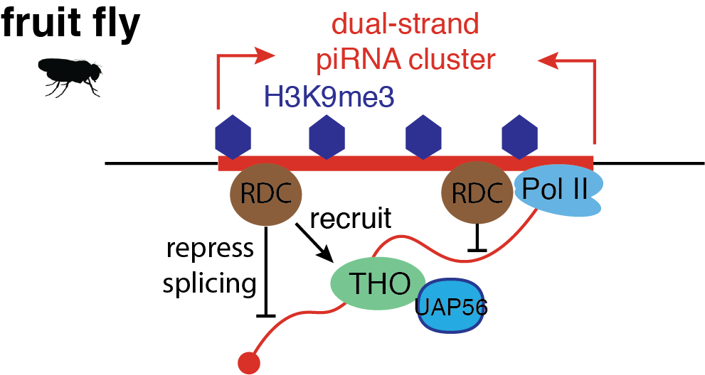
THO complex specifically binds long and unspliced piRNA-producing transcripts
Results
Zhang and Tu et al. Cell Rep, 2018
Hur et al. Genes Dev, 2016
Zhang et al. Cell, 2014
Mohn et al. Cell, 2014
Yu et al., Nature Communications. 2021
Tianxiong Yu, Weng Lab
Mar 2022, 8th Annual RNA Symposium
Notes:
Beyond histone modification, we also analyzed the THO complex, which is a known nuclear export complex for piRNA genes in fruit flies, and we are eager to see whether THO have something to do for piRNA-producing transcripts in mammals. The right figure compares the signal of THO RIP-seq data and the IgG control data for all genes separated by different types. While there is no significant enrichment of THO binding over control for mRNA, lincRNA, which is marked in black, and short first exon piRNA genes, which is marked in pink. Those piRNA genes lacking splicing and have long first exons, which are marked in red shown significant THO complex binding, which suggests THO complex might be able to specifically recognize and bind transcripts lack splicing and handle them into the piRNA biogenesis pathway.

Slide 16
THO complex specifically binds long and unspliced piRNA-producing transcripts
Results
Zhang and Tu et al. Cell Rep, 2018
Hur et al. Genes Dev, 2016
Zhang et al. Cell, 2014
Mohn et al. Cell, 2014
Yu et al., Nature Communications. 2021
Tianxiong Yu, Weng Lab
Mar 2022, 8th Annual RNA Symposium
Notes:
Beyond histone modification, we also analyzed the THO complex, which is a known nuclear export complex for piRNA genes in fruit flies, and we are eager to see whether THO have something to do for piRNA-producing transcripts in mammals. The right figure compares the signal of THO RIP-seq data and the IgG control data for all genes separated by different types. While there is no significant enrichment of THO binding over control for mRNA, lincRNA, which is marked in black, and short first exon piRNA genes, which is marked in pink. Those piRNA genes lacking splicing and have long first exons, which are marked in red shown significant THO complex binding, which suggests THO complex might be able to specifically recognize and bind transcripts lack splicing and handle them into the piRNA biogenesis pathway.

Slide 17
Results
Long and intronless is a conserved feature of piRNA genes in mammals
Tianxiong Yu, Weng Lab
Mar 2022, 8th Annual RNA Symposium

Slide 18
Results
Unspliced retroviral transcripts are processed into piRNAs
Koala retrovirus (KoRV)
Yu et al., Cell. 2019
Tianxiong Yu, Weng Lab
Mar 2022, 8th Annual RNA Symposium
Notes:
Then we turned into koalas. In koalas, the koala retrovirus expresses two isoforms, one is spliced to translate into envelope, and other one is unspliced to make gag and pol and form the virus genome. Our data and analysis showed only the unspliced KoRV transcript is processed into piRNAs. From the RNA-seq we can see most KoRV transcripts are spliced, with the splicing index at 5. However, for the piRNAs sequenced from small RNA libraries, they are evenly distributed across the whole koala retrovirus genome, and the splicing index is way smaller than KoRV transcripts inferred by RNA-seq, suggesting the KoRV piRNAs are mainly produced from unspliced transcripts.

Slide 19
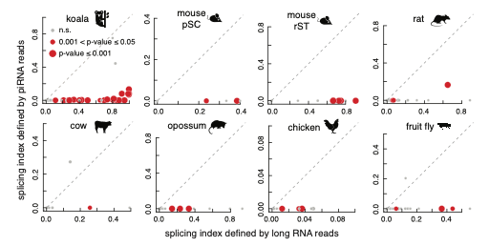
Results
Unspliced retroviral transcripts are processed into piRNAs
Tianxiong Yu, Weng Lab
Mar 2022, 8th Annual RNA Symposium

Slide 20
Results
THO specifically binds to unspliced KoRV transcripts
Koala retrovirus (KoRV)
Tianxiong Yu, Weng Lab
Mar 2022, 8th Annual RNA Symposium
Notes:
My colleagues also did RIP-seq for the THO complex in koala testis. When comparing the THO binding signal to IgG control, we didn't see enrichment at both ends of the KoRV genome. But we did find significant enrichment at the gag and pol regions, which is specific to the unspliced transcript. We can also see there is more splicing in the control data compare to the THO RIP-seq data, which is indicated by the splicing index. So together, the data also support our hypothesis that the THO complex can specifically recognize long and unspliced transcripts and send them to the piRNA biogenesis pathway to process into piRNAs.

Slide 21
Lack of splicing as a determinant feature for piRNA-producing transcripts
Conclusion
nuclear export
piRNA production
Tianxiong Yu, Weng Lab
Mar 2022, 8th Annual RNA Symposium
Notes:
In conclusion, we’ve performed integrative analysis for piRNA-producing transcripts in both mice and koalas, and found that lack of splicing is a unified feature that distinguishes both long first exon piRNA transcripts and unspliced endogenous retrovirus transcripts from other RNAs. And this feature can be recognized by THO complex, which might help the nuclear export and handle them into the piRNA biogenesis pathway.

Slide 22
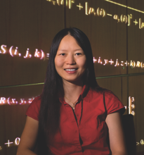



Acknowledgements
Weng Lab
Theurkauf Lab
Zamore Lab
Chappell Lab:
Keith Chappell
Sara Pagliarani
Luban Lab:
Jeremy Luban
Noah Silverstein
Zhiping Weng
Bill Theurkauf
Birgit Koppetsch
Gen Zhang
Philip Zamore
Deniz Ozata
Kaili Fan
Tianxiong Yu, Weng Lab
Mar 2022, 8th Annual RNA Symposium
Notes:
Lastly, I want to thank every person involved in our study. Especially my mentors Zhiping Weng, Bill Theurkauf, and Phil Zamore, and my colleagues Kaili and Birgit. I also want to thank the Symposium committes, and thank you all for your time and attention. And I would be happy to take any questions.

